Slide 1
Quantitative Research

Slide 2
An Introduction to Quantitative Research

Slide 3
What is Quantitative Research?
Formal, objective, rigorous, systematic process for generating information
Describes new situations, events, or concepts
Examines relationships among variables
Determines the effectiveness of treatments

Slide 4
Types of Quantitative Research
Descriptive
Quasi-experimental
Correlational
Experiemental

Slide 5
How Would You Describe Correlational Research?
Looks at the relationship between two or more variables
Determines the strength and type of relationship
Explains what is seen
No cause and effect

Slide 6
How about Quasi-experimental Research?
Examines cause-and-effect relationships
Less control by researcher than true experimental designs
Samples are not randomly selected.
All variables in the study cannot be controlled by the researcher.

Slide 7
What are the Main Characteristics of Experimental Research?
Controlled manipulation of at least one independent variable
Uses experimental and control groups
Random assignment of the sample to the experimental and control groups

Slide 8
What is the Aim of Experimental Research?
Looks at cause-and-effect relationships
Highly controlled, objective, systematic studies
Involves the measurement of independent and dependent variables

Slide 9
Important Concepts in the Quantitative Research Process
Basic Research
Applied Research
Rigor
Control
Extraneous Variables
Sampling

Slide 10
What is Applied Research?
Attempts to solve real problems in clinical practice
Studies the effects the intervention may have on patients
Applies findings in the real world on real patients

Slide 11
Why is Rigor Important?
Striving for excellence in research and adherence to detail
Precise measurement tools, a representative sample, and a tightly controlled study design
Logical reasoning is essential.
Precision, accuracy, detail, and order required

Slide 12
What Measures of Control are Utilized?
Rules that are followed to decrease the possibility of error in part determine the design of the study.
Different levels of control depending on study
Quasi-experimental studies partially controlled regarding selection of subjects
Experimental studies highly controlled because of precision of sample selection

Slide 13
Control in Quantitative Research
Type of Quantitative Research | Researcher Control | Research Setting
Descriptive | Uncontrolled | Natural or partially controlled
Correlational | Uncontrolled or partially controlled | Natural or partially controlled
Quasi-experimental | Partially controlled | Partially controlled
Experimental | Highly controlled | Laboratory

Slide 14
What are Extraneous Variables?
These occur in all research studies (and in everyday life!).
They may interfere with the hypothesized relationships between variables.
The influence of extraneous variables can be decreased through sample selection and the use of defined research settings.

Slide 15
What are Sampling and Sampling Methods?
Process of selecting subjects who are representative of the population
Random sampling
Each member has an equal chance of being selected.
Has the most control
Convenience sampling
Whoever is available

Slide 16


Settings in Quantitative Research
Natural or field settings
Partially controlled settings
Highly controlled or laboratory settings

Slide 17
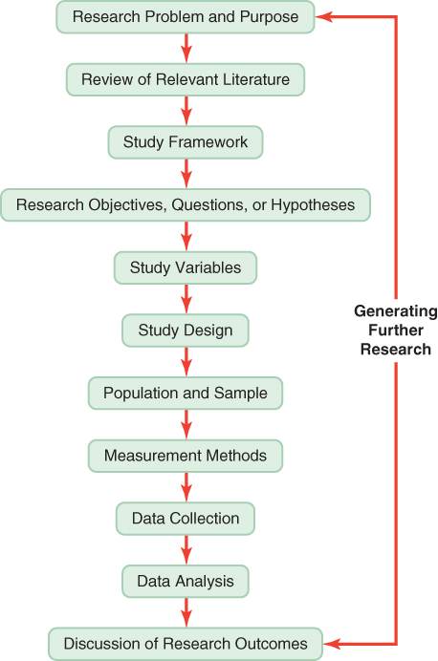
Steps in Quantitative Research

Slide 18
Review: Research Problems and Purposes
Research problem is an area of concern needing research for nursing practice.
The problem identifies, describes, or predicts the research situation.
Research purpose comes from the problem and identifies the specific goal or aim of the study.
The purpose includes variables, population, and setting for the study.

Slide 19
Review: Literature Review
Collecting pertinent literature to give in-depth knowledge about the problem
Understanding what knowledge exists to make changes in practice

Slide 20
Review: Study Framework
Framework is the abstract, theoretical basis for a study that enables the researcher to link the findings to nursing’s body of knowledge.
Theory is an integrated set of defined concepts and relational statements that present a view of a phenomenon and can be used to describe, explain, predict, or control phenomena.

Slide 21
Review: Research Objectives, Questions, and Hypotheses
All identify relationships between variables and indicate population to be studied
Narrower in focus than the purpose and often specify only one or two research variables

Slide 22
Review: Study Variables
Variables are concepts that are measured, manipulated, or controlled in a study.
Concrete variables: temperature, weight
Abstract variables: creativity, empathy
Conceptual definition: gives meaning to a concept
Operational definition: variable can be measured using this description

Slide 23
Assumptions
Statements are taken for granted or are considered true.
Assumptions are often unrecognized in thinking and behavior.
Sources of assumptions are universally accepted truths.
They are often embedded in the philosophical base of the study’s framework.

Slide 24
Limitations
Restrictions in a study that may decrease the credibility and generalizability of the findings
Important to note whether or not limitations are addressed in the research report you are reading! The author(s) should report their identified limitations. This is often done in a separate section or paragraph at the end of the report. As a reader, you may also note additional limitations not addressed by the author(s). This is an important are for critique.

Slide 25
Limitations
Theoretical limitations
Restrict the generalization of the findings
Reflected in the framework and definitions
Methodological limitations
Restrict the population to which the findings can be generalized
May result from an unrepresentative sample or weak design

Slide 26
Research Design
Blueprint for conducting the study
Maximizes control over factors that could interfere with the study’s desired outcome
Directs the selection of the population, sampling, methods of measure, plans for data collection, and analysis

Slide 27
Problem-Solving Process
Data collection
Problem definition
Plan
Setting goals
Identifying solutions
Implementation
Evaluation and revision

Slide 28
Quantitative Research Designs in More Detail

Slide 29
What does a Research Design look like?
Blueprint or detailed plan for conducting a study
Purpose, review of literature, and framework provide the basis for the design

Slide 30
What is the Purpose of a Research Study?
To describe variables
To examine relationships
To determine differences
To test a treatment
To provide a base of evidence for practice
OR a combination of the above!

Slide 31
Quantitative Research Designs
Descriptive
Correlational
Quasi-experimental
Experimental

Slide 32
Linking the Purpose to the Design
The design of the quantitative research study must match with the purpose
As an example, it would not be appropriate to have a purpose of describing a set of variables with an experimental design, which is really meant to test a treatment or intervention

Slide 33
Descriptive Designs
Typical descriptive design
Comparative descriptive design
Case study design

Slide 34
Descriptive Designs
Most commonly used design
Examines characteristics of a single sample
Identifies phenomenon, variables, and conceptual and operational definitions and describes definitions

Slide 35
Comparative Descriptive Designs
Examines differences in variables in two or more groups that occur naturally in a setting.
Results obtained from these analyses are frequently not generalizable to a population.

Slide 36
Case Study Designs
Exploration of single unit of study (e.g., family, group, or community)
Even though sample is small, number of variables studied is large.
Design can be source of descriptive information to support or invalidate theories.
It has potential to reveal important findings that can generate new hypotheses for testing.
There is no control.

Slide 37
Correlational Designs
Descriptive correlational design
Predictive correlational design
Model testing design

Slide 38
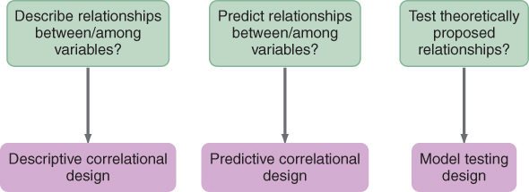
Determining the Type of Correlational Design

Slide 39
What are the Benefits of an Experimental Design?
More controlled design and conduct of study
Increased internal validity: decreased threats to design validity
Fewer rival hypotheses

Slide 40
What are the Essential Elements of an Experimental Design?
Random assignment of subjects to groups
Researcher-controlled manipulation of independent variable
Researcher control of experimental situation and setting, including control/comparison group
Control of variance
Clearly spelled out sampling criteria
Precisely defined independent variable
Carefully measured dependent variable

Slide 41
What are Study Groups?
Groups in comparative descriptive studies
Control group
Comparison group
Equivalent vs. nonequivalent groups

Slide 42
What is a Randomized Clinical Trial?
The design uses large number of subjects to test a treatment’s effect and compare results with a control group who did not receive the treatment.
The subjects come from a reference population.
Randomization of subjects is essential.
Usually multiple geographic locations are used.

Slide 43
What are Interventions in Experimental Research?
Interventions should result in differences in posttest measures between the treatment and control or comparison groups.
Intervention could be physiological, psychosocial, educational, or a combination.
Nursing is developing a classification system for interventions.

Slide 44
Guidelines for Critically Appraising Interventions
Was the experimental intervention described in detail?
Was justification from the literature provided for development of the intervention, and what is the current knowledge?
Was a protocol developed to ensure consistent implementation of the treatment?
Did the study report who implemented the treatment?

Slide 45
Guidelines for Critically Appraising Interventions
Was any control group intervention described?
Was an intervention theory provided to explain conclusions?

Slide 46
Concepts Relevant to Design
Causality
Probability
Bias
Control
Manipulation

Slide 47
Causality
There is a cause-and-effect relationship between the variables.
The simplest view is one independent variable causing a change in one dependent variable.
Independent variable (X) causes Y (a change in the dependent variable).

Slide 48
Multicausality
There is a cause-and-effect relationship between interrelating variables.
There are multiple independent variables causing a change in the dependent variable.

Slide 49
Causality: A B
Pressure Ulcer
Multicausality:
Years smoking
High-fat diet Heart disease
Limited exercise

Slide 50
Probability
The likelihood of accurately predicting an event
Variations in variables occur.
Is there relative causality?
Therefore, what is the likelihood that a specific cause will result in a specific effect?

Slide 51
Bias
The slanting of findings away from the truth
Bias distorts the findings.
Research designs should be developed to reduce the likelihood of bias or to control for it.

Slide 52
What are Potential Causes of Bias in Research Designs?
Researchers
Components of the environment and/or setting
Individual subjects and/or sample
How groups were formed
Measurement tools
Data collection process
Data and duration of study
Statistical tests and analysis interpretation

Slide 53
Factors Influencing Control
Implemented throughout the design
Improved accuracy of findings
Increased control in quasi-experimental research
Greatest in experimental research

Slide 54
Manipulation
Implementation of a treatment or intervention
The independent variable is controlled.
Must be careful to avoid introduction of bias into the study
Usually done only in quasi-experimental and experimental designs

Slide 55
What are the Elements of a Strong Design?
Controlling environment: selection of study setting
Controlling equivalence of subjects and groups
Controlling treatment (Tx)
Controlling measurement
Controlling extraneous variables

Slide 56
EXPERIMENTAL RESEARCH DESIGN

Slide 57
Leading Questions
Can you think of an example of an experimental research design for language learning research? What is it about?
Can you think of an example of a weak experimental design? What makes it weak?
Can you think of an example of a strong experimental design? What makes it strong?

Slide 58
What is a research design?
a systematic outline of the plans, stages, and strategies involved in each of the experimental research processes.
There are at least four major experimental research designs:
pre-experimental
single-case
randomized experimental
quasi-experimental designs

Slide 59
Pre-experimental Designs
No random assignment
May be carried out in an intact or existing class
Many other variables (apart from the independent variable of interest) could play a role in influencing any findings
Good as or recommended as a pilot study (pre-trial).

Slide 60
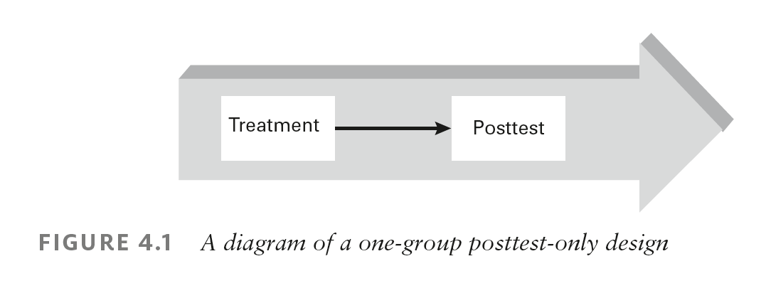
One-group Posttest-only Design

Slide 61
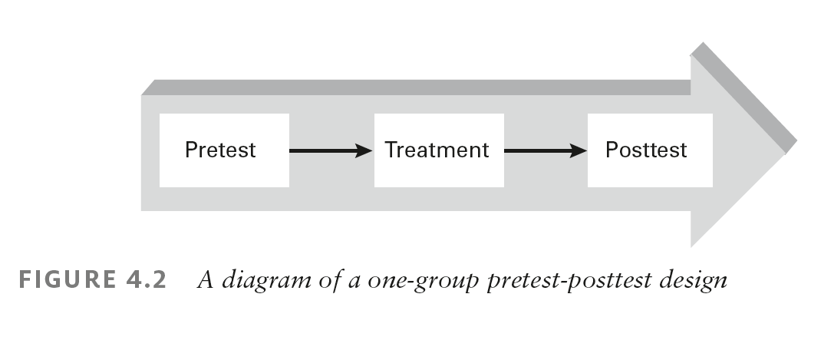
One-group Pretest-posttest Design

Slide 62
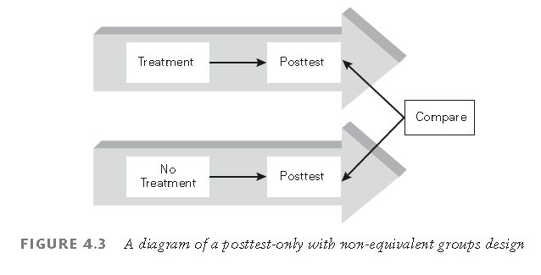
Posttest-only with Non-equivalent Groups design

Slide 63
Single-case Designs
aims to examine whether an intervention is effective for a particular individual in terms of improvements in learning or behaviors.
has a sample size of one participant.
no comparison group or random assignment
should not be confused with a case study.
an extension of the quasi-experimental, one-group time-series design.

Slide 64
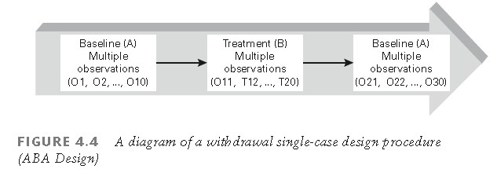
A withdrawal single-case design

Slide 65
True Experimental Designs
3 important aspects of true experimental designs: Manipulation of independent variables, randomization, and comparison groups
Manipulation techniques include: the presence or absence technique, the amount technique, and the type technique
Random assignment is a randomization technique used to place research participants into groups (e.g., experimental or control groups.

Slide 66
True Experimental Designs
Comparison Groups: two or more equivalent groups with different conditions for the purpose of comparison.
The group which receives the treatment (i.e., interaction activity) is called the experimental group.
The group that does not receive the treatment is called the control group.

Slide 67
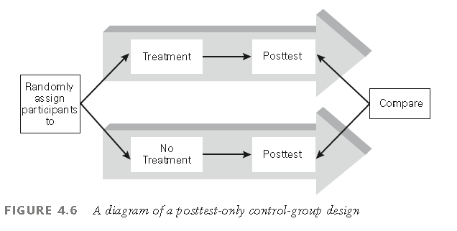
Posttest-Only Control-Group Designs

Slide 68
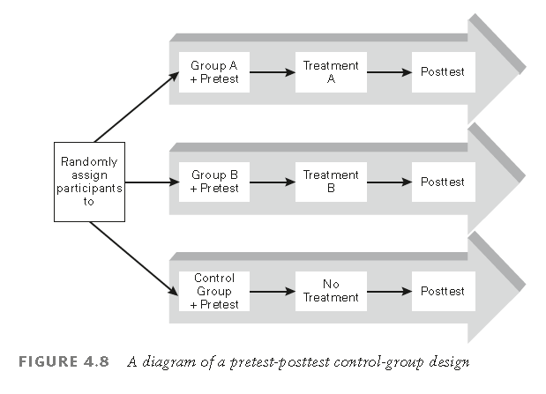
Pretest-Posttest Control-Group Designs

Slide 69
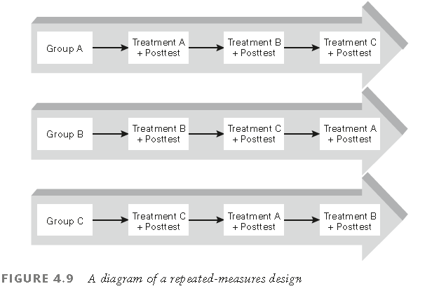
Repeated-measures Design

Slide 70
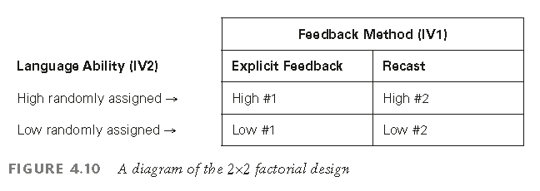
Factorial Designs

Slide 71
Quasi-experimental Designs
The term ‘quasi’ is Latin for ‘almost’.
cannot do random assignments in quasi-experimental research
In real life situations, there are intact classes that cannot be rearranged.
Hence, researchers cannot achieve complete control over potential confounding variables that can be threats to the internal validity of the study

Slide 72
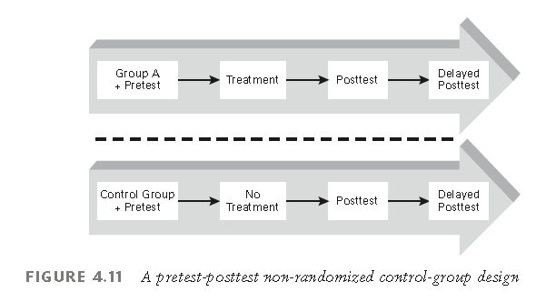
Pretest-Postest Nonrandomized Control Group Designs

Slide 73
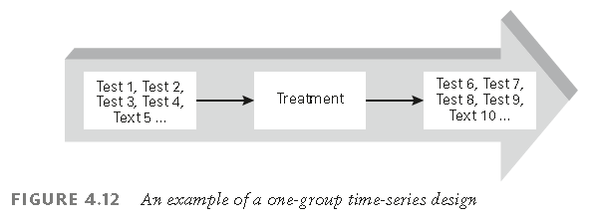
One-group or Control-group Time-series Designs

Slide 74
Methods for Random Assignment in Experimental Research
The Coin-toss Technique
The Block-randomized Technique
The Matching Technique
group matching technique
pair matching technique

Slide 75
Limitations of Experimental Research
Limitations due to language learners: Language learning is highly complex and multidimensional; learners’ background characteristics, psychological traits, and social settings
Limitations due to researchers: difficult to be fully objective in their observation

Slide 76
Discussion
Experimental research requires control over a situation in which research validity must be safeguarded. Why is it important to control variables in experimental research?
We have discussed three typical experimental techniques to manipulate an independent variable of interest (i.e., the presence or absence technique, the amount technique, and the type technique). Which experimental designs discussed so far apply any of these techniques?

Slide 77
What Questions should you ask to Critically Appraise a Study Design?
Was the type of design identified?
Was the study design linked to the purpose and/or objectives, questions, or hypotheses?
Were all variables manipulated or measured?

Slide 78
What Questions should you ask to Critically Appraise a Study Design?
If the study included a treatment, was it clearly described and consistently implemented?
Were extraneous variables identified and controlled?
What were threats to design validity in the study?

Slide 79
What Questions should you ask to Critically Appraise a Study Design?
Was a pilot study performed?
What was the reason for the pilot and the outcome?
Study feasibility
Refine design or treatment
Examine validity and reliability of measurement methods

Slide 80
What Questions should you ask to Critically Appraise a Study Design?
How adequate was the manipulation?
What elements should have been manipulated to improve the validity of the findings?
Based on your assessment of the adequacy of the design, how valid are the findings?
Is there another reasonable (valid) explanation (rival hypothesis) for the study findings other than that proposed by the researcher?

Slide 81
What Questions should you ask to Critically Appraise a Study Design?
Identify elements controlled in the study.
Identify possible sources of bias.
Are there elements that could have been controlled to improve the study design?
What elements of the design were manipulated, and how were they manipulated?

Slide 82
Questions? Comments?
The end!

